Slide 1
Hospitality Project Presentation
From: Group 3
Kishore Kumar Agidi
Anju Vettathil
Shazmeen Fathima
P Vijay Kumar
shalu Sharma
Vishal Kanti Rajput
Ponnam Manisha

Slide 2
Introduction:
Hospitality means the friendly and generous reception of guests, visitors, or strangers.
It involves providing comfort, care, and services in industries like hotels, restaurants, and tourism.
In business, hospitality focuses on creating positive guest experiences, improving satisfaction, and building long-term relationships.
It can refer to the personal act of a host welcoming someone to their home or, more broadly, to a commercial industry that provides services like food, drink, accommodation, and entertainment to paying customers

Slide 3
Objectives:
Understand and analyze hospitality industry data
Build dashboards using Excel, Power BI, Tableau, and SQL
Identify patterns and KPIs for decision-making
Provide insights for improving occupancy and revenue
Develop recommendations for data-driven hospitality management

Slide 4
KPI CARDS
The business achieved 1.71B in revenue with 134,590 bookings, maintaining a healthy utilization of 57.87% despite a 24.83% cancellation rate.”

Slide 5
Problems Faced
Difficulty cleaning and integrating data from multiple sources
Handling large datasets in Excel and SQL
Query errors and optimization issues in SQL
Designing visually appealing and interactive dashboards
Duplicate bookings, null values, and inconsistent formats (e.g., date/time or currency) lead to incorrect reports.
Large data volumes (e.g., years of bookings, transactions) slow down dashboards in Power BI/Tableau.
Some Dashboard look goods on desktop but break on mobile/tablets.

Slide 6
Solutions
Adopt proper data cleaning techniques before visualization
Use efficient SQL queries with joins and indexing
Standardize data formats across all tools
Design dashboards with clear KPIs and filters
Use tooltips, slicers, and filters in Power BI/Tableau for interactivity.
Include legends and data labels for clarity.
Leverage Power BI and Tableau for interactive reporting
Regular testing and validation of dashboards

Slide 7
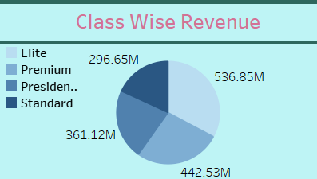
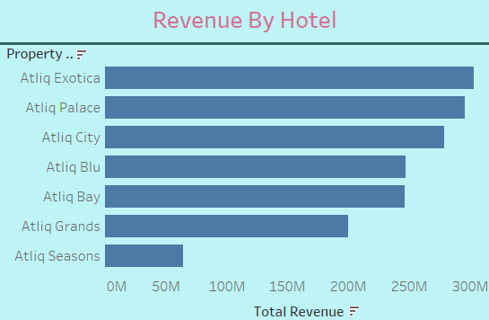
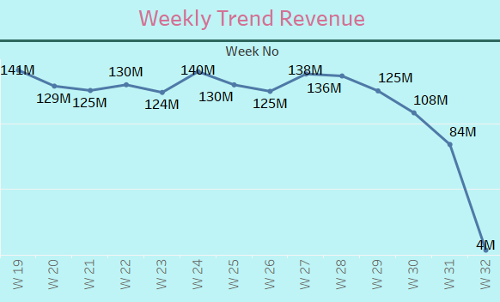
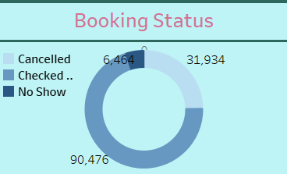
Visuals

Slide 8
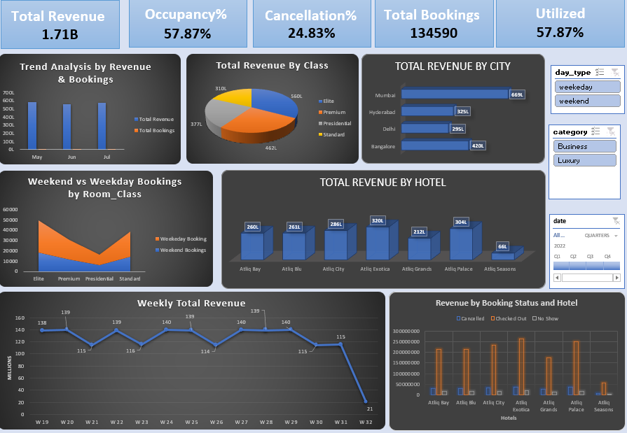
Excel_Dashboard

Slide 9
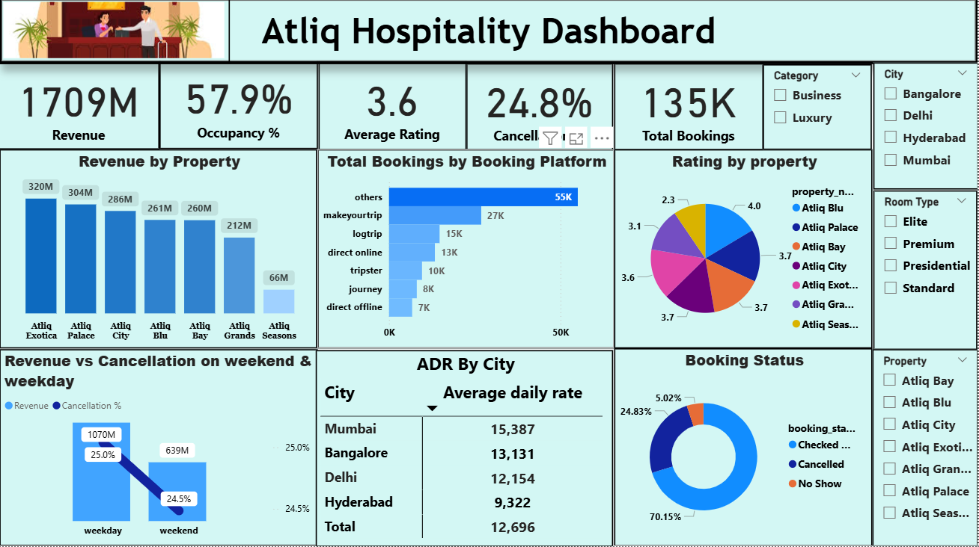
PowerBI DashBoard

Slide 10
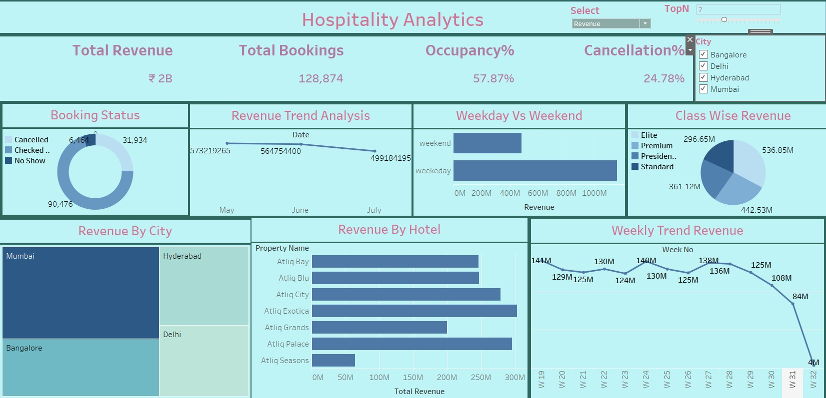
Tableau DashBoard

Slide 11
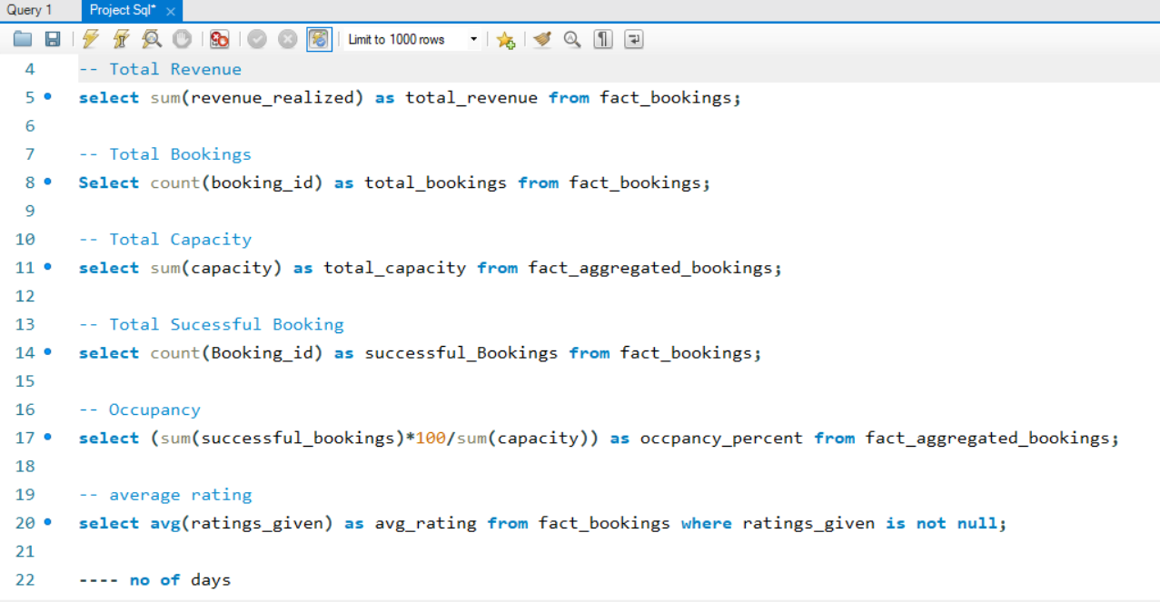
SQL Queries

Slide 12
Conclusion
The hospitality project has provided valuable insights into how data-driven tools like Power BI, Tableau, Excel, and MySQL can significantly enhance operational efficiency, guest satisfaction, and decision-making processes within the hospitality industry.
By designing and implementing interactive dashboards, we successfully integrated multiple data sources to track key performance indicators (KPIs) such as occupancy rates, revenue, customer feedback, and operational costs. This not only improved transparency and reporting accuracy but also empowered management to make informed, strategic decisions in real-time
In conclusion, this project reinforces that technology and data intelligence are essential for delivering exceptional guest experiences and achieving operational excellence in today’s hospitality landscape.

